Slide 1

Big Data & Personalized Medicine Application to Cancer Therapy
Not Yet AI
Brandi Cantarel, PhD
Assistant Professor, Bioinformatics

Slide 2
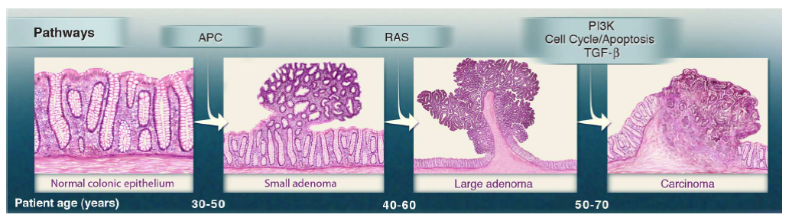
Cancer Cell Evolution
From Vogelstein et al., Science 2013
Progressive accumulation of pathogenic mutations in oncogenes culminates in the development of cancer

Slide 3
Personalize Cancer Therapy targets the “oncogenic drivers” of a tumor
Precision medicine is an approach to patient care that allows doctors to select treatments that are most likely to help patients based on the molecular mechanism of their disease

Slide 4
Genetic Changes in Tumors as a Proxy for Changes in Cellular Function
An oncogene is a gene that has the potential to cause cancer because it promotes cell growth or represses apoptosis
In tumor cells, oncogenes are often mutated or expressed at high levels.
A tumor suppressor gene can have a damping or repressive effect on the regulation of the cell cycle and/or promote apoptosis
In tumor cells, alternation in TSGs cause a loss or reduction in its function, thus promoting cell growth or the repression of apoptosis

Slide 5
Targeted Therapies and Immunotherapies can improve cancer patient survival
Sharma et al. Cell. 2015 PMID: 25860605

Slide 6
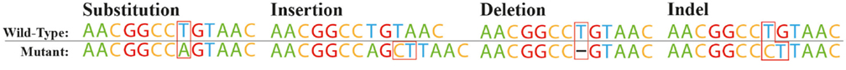
Forms of Genetic Variation
Single Point Mutation (SNV)
Insertion/Deletion (InDel)
Copy Number Variation (CNV)
Translocations
Internal Tandem Duplication (ITD)
Cardoso JG, Andersen MR, Herrgård MJ, Sonnenschein N. Analysis of genetic variation and potential applications in genome-scale metabolic modeling. Front Bioeng Biotechnol. 2015 Feb 16;3:13. doi: 10.3389/fbioe.2015.00013. eCollection 2015. Review. PubMed PMID: 25763369; PubMed Central PMCID: PMC4329917.

Slide 7
CNV
Loss of Tumor Supressors or Amplification of Oncogenic genes can lead to tumor formation
Her2 Amplification (Her2+) can be treated with a number of inhibitors (trastuzumab, lapatinib, pertuzumab, or ado-trastuzumab emtansine) that have been shown (in combinations with Chemotherapy, to prolong overall survival

Slide 8
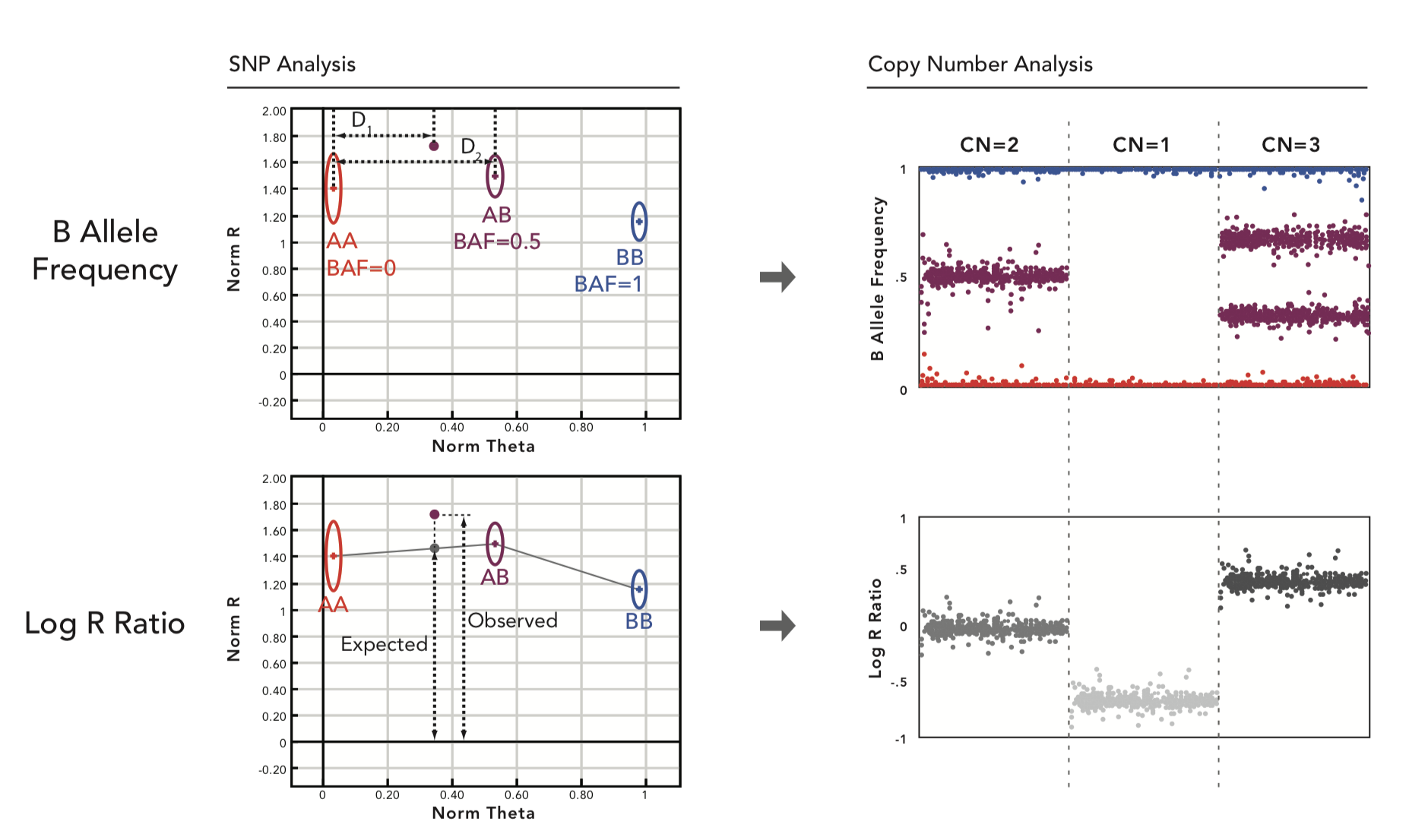
CNV Detection
Microarray
Next Generation Sequencing

Slide 9
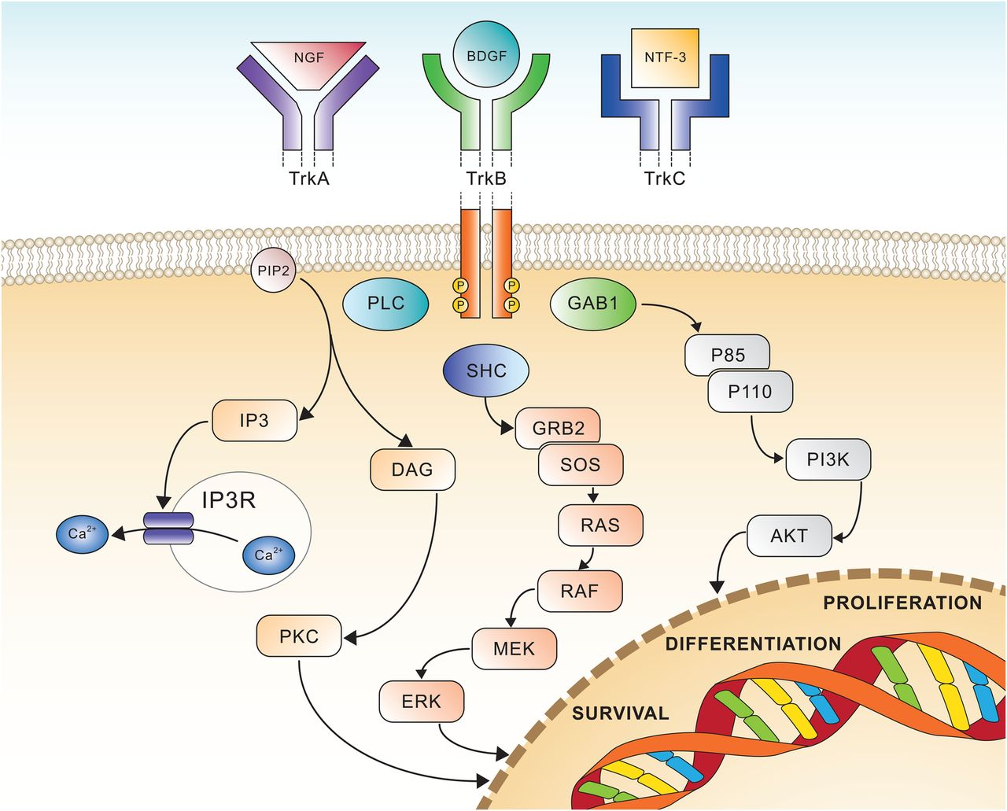
Gene Fusions/Translocations
The discovery of BRC-ABL gene fusions as a driver mutation of Chronic Myeloid Leukemia (CML) led to the development of imatinib (selective inhibitor), which improves the overall survival rates of CML patients to 90% over 5 years and 88% over 8 years
NTRK Fusions lead to transcription of chimeric proteins with constitutively activated or overexpressed kinase function conferring oncogenic potential. Vitrakvi, an NTRK inhibitor, has been approved for treatment in various tumor types, including soft tissue sarcoma, salivary gland, infantile fibrosarcoma, thyroid, lung, melanoma, colon, GIST, cholangiocarcinoma, appendix, breast and pancreas

Slide 10
FISH
fluorescence in situ hybridization
FISH is the gold standard for chromosomal translocations detection
ABL
BCR
Adapted from Primo et al.54 Reprinted by permission from Macmillan Publishers Ltd: Leukemia 17: 1124–1129, copyright 2003.

Slide 11
Internal Tandem Duplication
ITDs in FLT3 is common in acute myloid leukaemia
FLT3-ITD has been associated with a bad prognosis, increased risk of relapse and shorter overall survival
Inhibitory drugs have been shown to increase survival

Slide 12
Intron Retention &
Exon Exclusion
In tumor suppressor, alterations in splicing can be a type of loss of function mutation
intron retentions can lead to non-sense mediated decay
exon exclusion can lead to loss of protein function

Slide 13
How do we find targetable mutations?
Generate Good Quality Data
FISH
Microarray
Sanger Sequencing
Sequence Libraries, Gene targeting and Next-generation Sequencing
Predict genetic variation compared to the reference genome
Determine the impact and effect of this variation on genes
Predict variation likely to be functional
Determine which mutations are likely to be “clinically actionable.
FDA approved drugs
Clinical Trials
Determine if the profile of these mutation are clinical actionable (immunotherapies)

Slide 14
Data Generation
Whole Genome or Panel?
Sequencing
What is the difference between whole genome, whole exome and gene panels?
Quality assessment
Primary analysis
Short Read Alignment
Inherited vs Acquired Variation Detection
Different Types of Genetic Variation (SNVs, Indels, SVs)

Slide 15
Sequencing Applications
Sanger Sequencing (~1kb)
Used to identify the common pathogenic driver mutations in a few genes: KRAS, EGFR, etc
1-100 amplicon targets
Microsatellite or STR analysis
Illumina Short Read Sequencing (50bp-300bp)
“Next-generation Sequencing”
Whole Genome Sequencing (WGS)
Amplicon-based Sequencing
uses primers
feasible for ~ 100 genes
Hybridization-based Sequencing
uses baits
feasible for any size gene panel from whole exome sequencing (WES) to small gene-panels

Slide 16
Genomic Sequencing
Whole Genome Sequencing
Good for detecting structural variation and non-coding mutations
More uniform coverage than panel sequencing
Typically sequenced at 30-40X coverage
Panel Sequencing
Cheaper than whole genome
Whole Exome is a panel of ~ 2% of the genome focusing on protein coding regions.
Typically sequenced at 80-100X coverage
Custom panel are typically 100-2000 genes
Typically sequenced at 500-1000X coverage

Slide 17
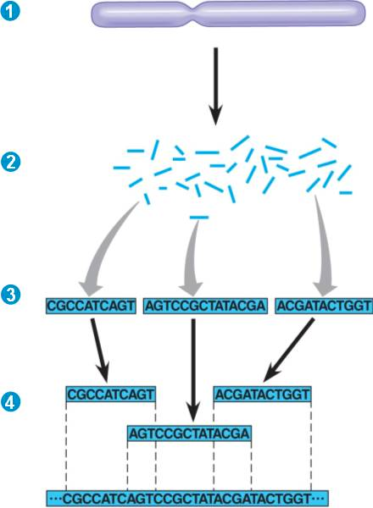
Whole Genome Shotgun
The Genome is fragmented
Sequence library is created with the dna fragments
For model organism, reads are mapped to a reference genome
For non-model organism, reads are assembled into contigs

Slide 18
Targeted Capture
Hybridization and Amplicon Based

Slide 19
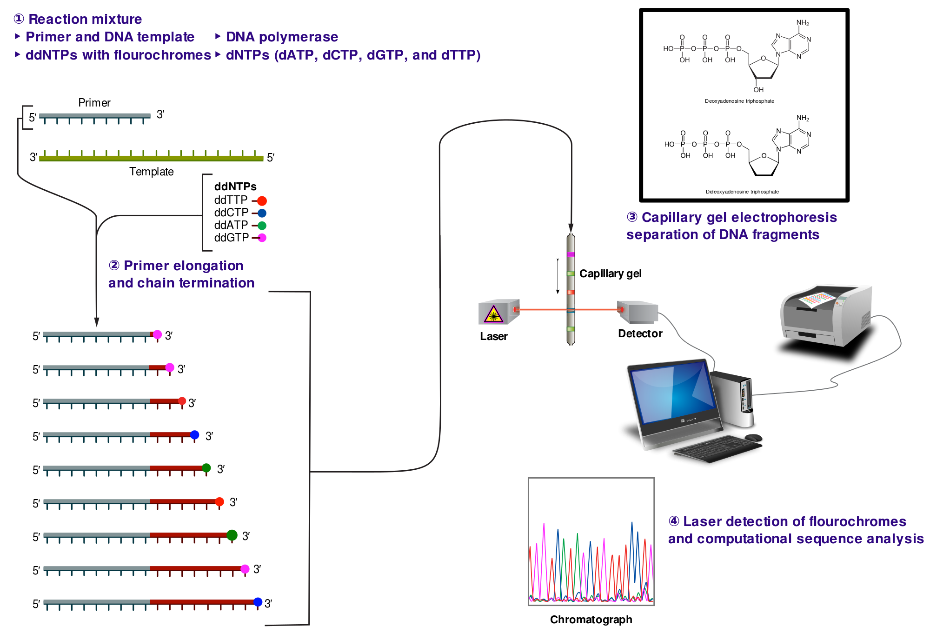
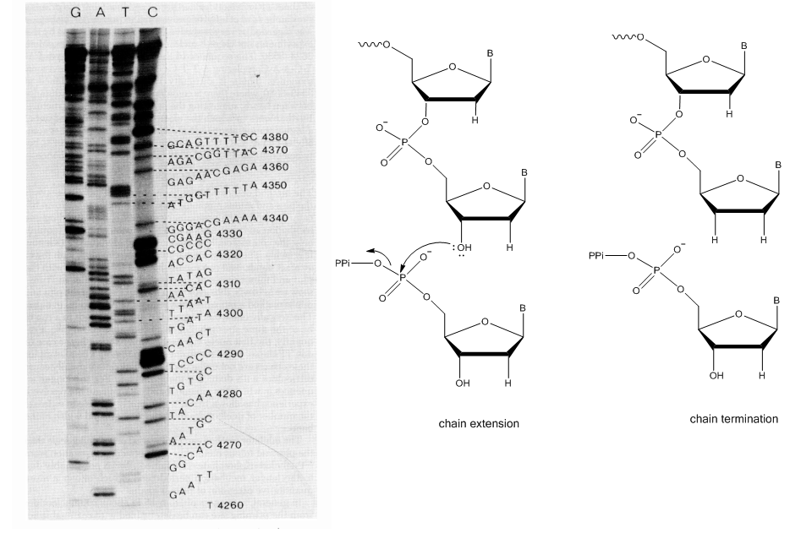
Sanger Sequencing
DNA Sequencing with chain-terminating inhibitors

Slide 20
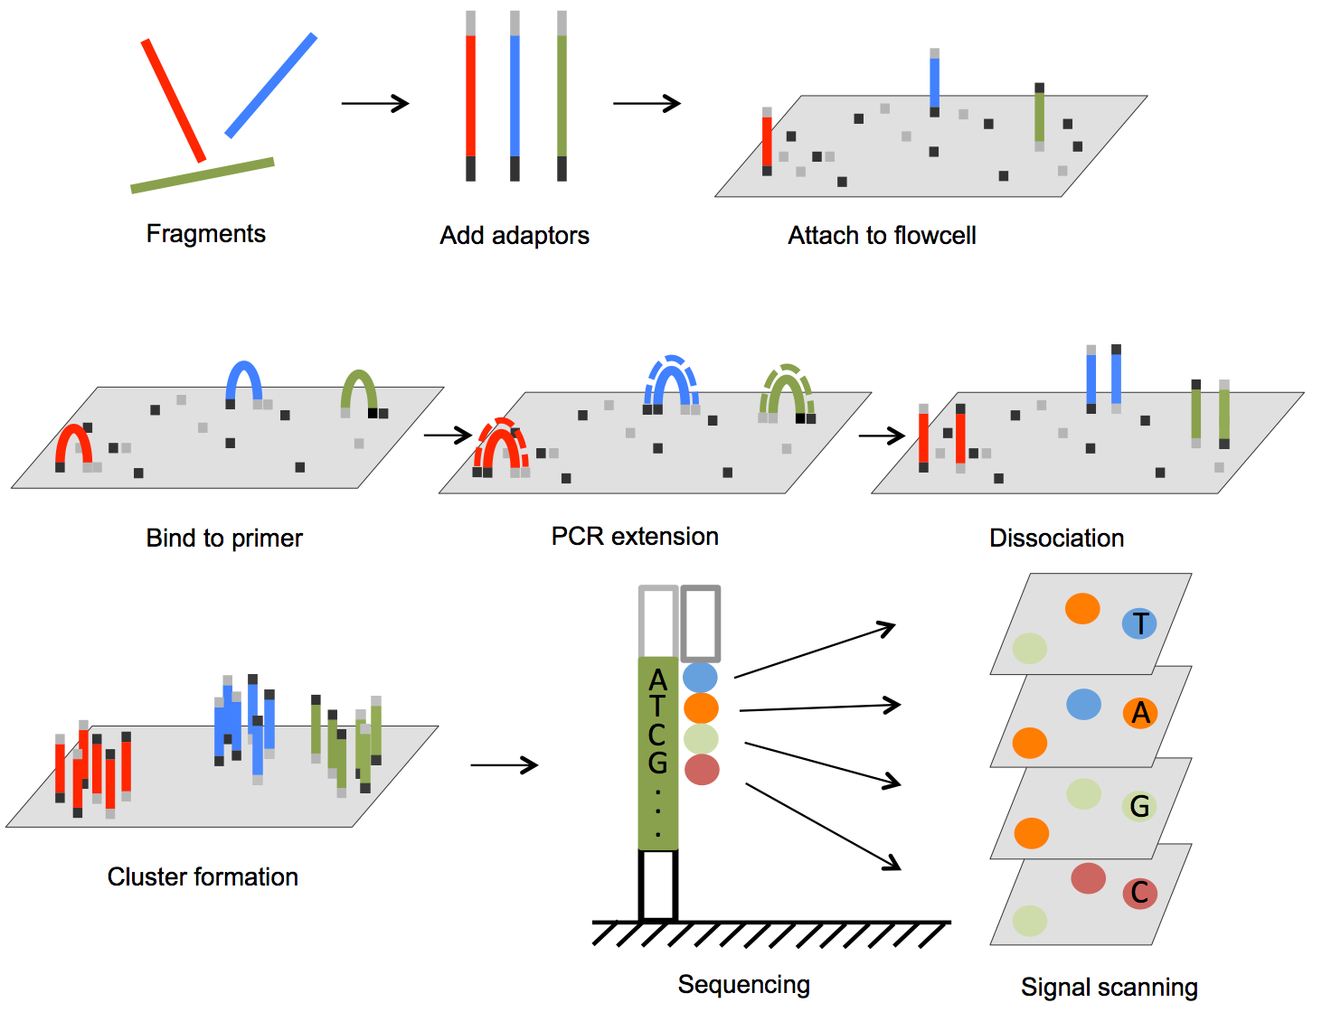
Illumina-Sequencing
(Next-Generation Sequencing)

Slide 21
“3rd Generation” Sequencing
Long Read High-Throughput Sequencing
PAC-Bio Single Molecule Real Time Sequencing
Useful for detecting structural variation
Read lengths as long as 10kb
Oxford Nanopore
In the field sequencing capability
Potential for bedside infectious disease identification

Slide 22
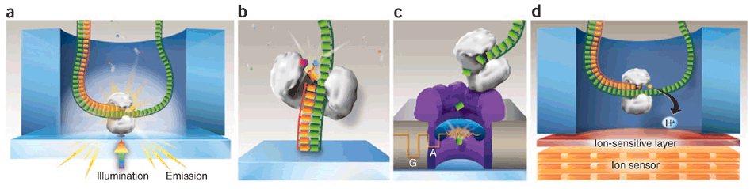
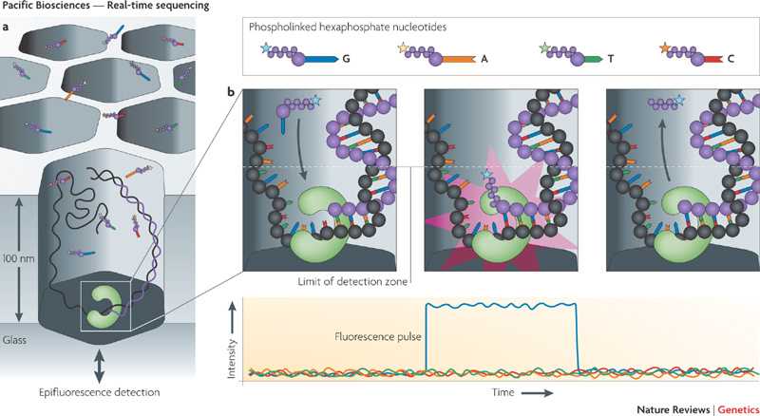
SMRT-Sequencing

Slide 23
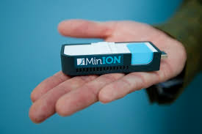
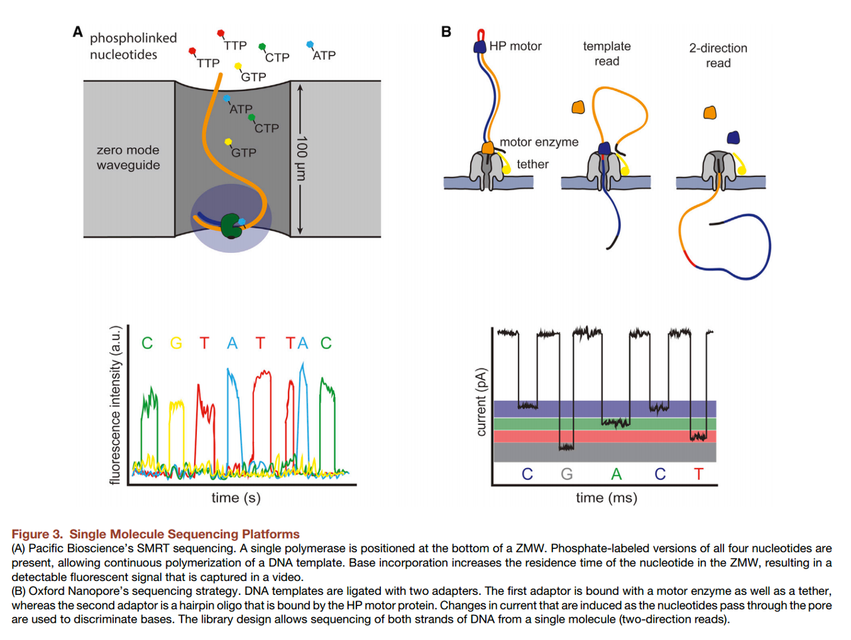
Oxford Nanopore MinIon
A “laptop powered” sequencing
MinION weighs under 100 g and plugs into a PC or laptop using a high-speed USB 3.0 cable
$600-$1000 for the run (10-50Gb of data) with read lengths from 1kb to > 1MB.
Error rates ~0.4% (similar to Illumina)

Slide 24
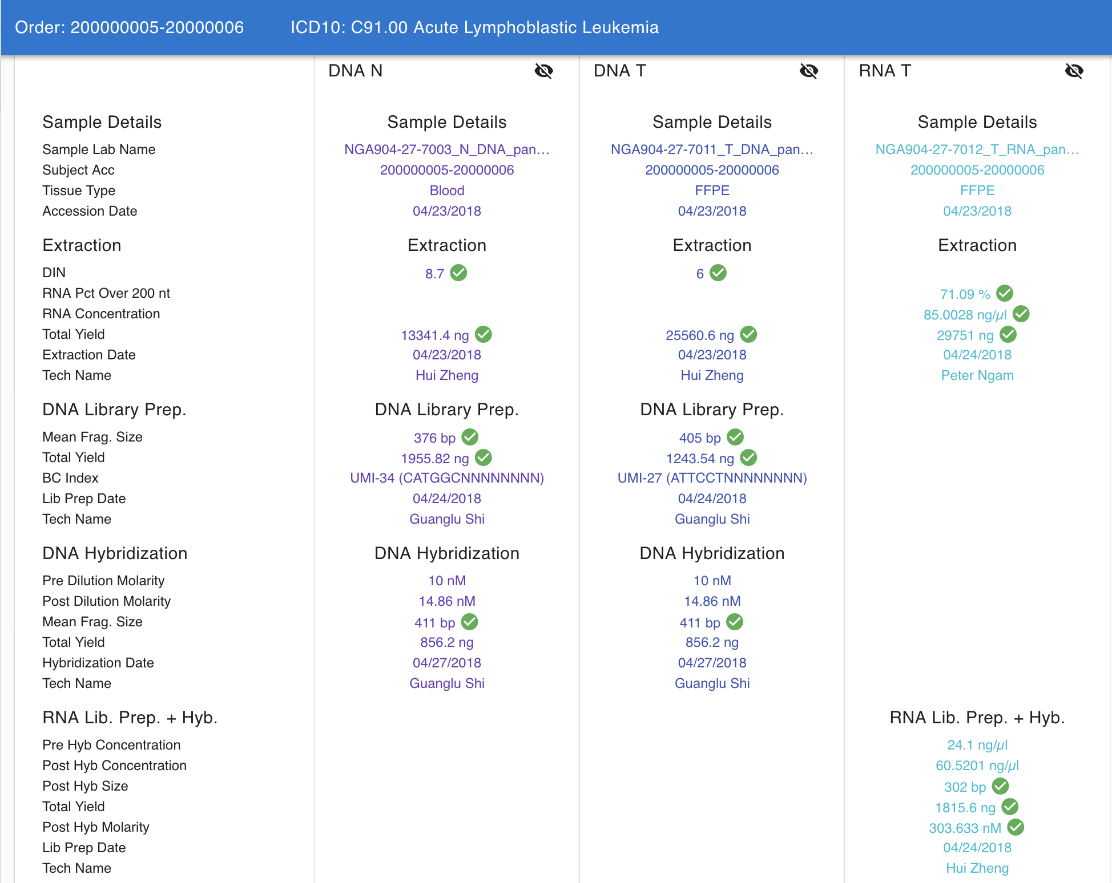
Quality Metric Tracking

Slide 25
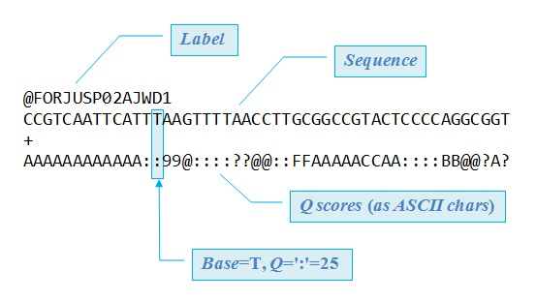
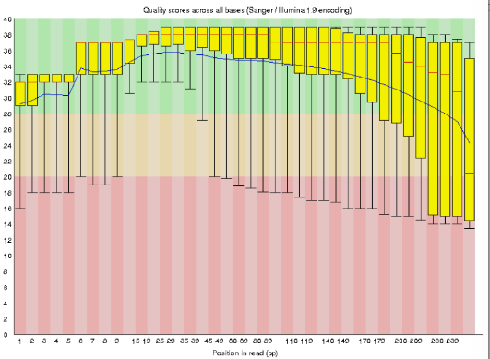
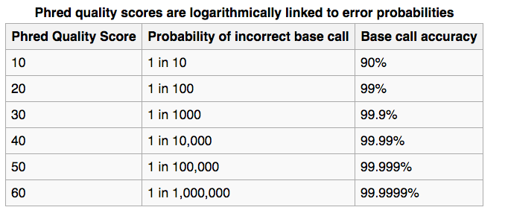
FastQ
Sequence and Quality
Base quality scores provide a measure on correctness of each base in the read

Slide 26
Data Generation
Sequencing
What is the difference between whole genome, whole exome and gene panels?
Quality assessment
Primary analysis
Short Read Alignment
Inherited vs Acquired Variation Detection
Different Types of Genetic Variation (SNVs, Indels, SVs)

Slide 27
How do we turn alignments into genetic mutations?
Short Read Alignment (mapping) onto a reference genome
Short read aligners assume that the read came from “intact” from the reference
Mutation or variation is assumed when reads deviate from the reference
Identification of differences between the reference genome and the genome of interest
hg19 reference genome is largely based on 5 individuals
hg38 includes population specific alternative chromosomes based on 1000G populations

Slide 28
Data Analysis
BCL File
BCL2Fastq
FASTQ
DNA
RNA
Alignment
No Saliva/Blood
Saliva/Blood
Tumor Only
+
Somatic
+
RNASeq
SNV/Indels/CNVs
Gene Fusions
Integrated VCF File
Translocations

Slide 29
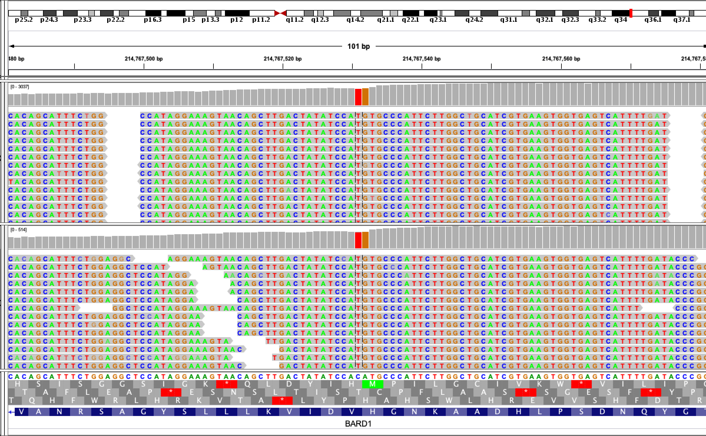
Alignment
Mismatches and Gaps can indicate a genetic variation (naturally occurring in a population) or mutation (an error in replication)

Slide 30
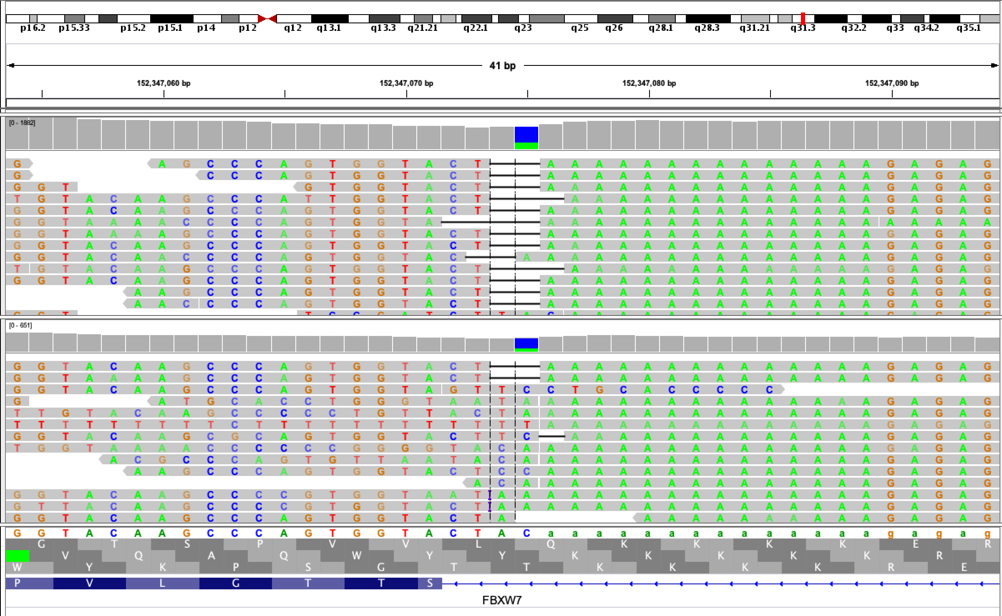
Alignment
Mismatches and Gaps can indicate a genetic variation (naturally occurring in a population) or mutation (an error in replication)

Slide 31
Differences in Variant Prediction Algorithms Accuracy
 |  | SNV |  |  |  |  | Indel
Sample | Callers | TP | FP | FN | SN | PPV | TP | FP | FN | SN | PPV
GM12878_FFPE | gatk | 1120 | 10 | 18 | 98.4 | 99.1 | 28 | 2 | 0 | 100 | 93.3
GM12878_FFPE | sam | 1124 | 2 | 14 | 98.8 | 99.8 | 17 | 1 | 11 | 60.7 | 94.4
GM12878_FFPE | ssvar | 1120 | 3 | 18 | 98.4 | 99.7 | 28 | 1 | 0 | 100 | 96.6
GM12878_FFPE | platypus | 1120 | 6 | 18 | 98.4 | 99.5 | 28 | 1 | 0 | 100 | 96.6
GM12878_FFPE | genomeseer | 1130 | 13 | 5 | 99.6 | 98.9 | 28 | 1 | 0 | 100 | 96.6
GM12878_FFPE | union | 1133 | 23 | 5 | 99.6 | 98 | 28 | 2 | 0 | 100 | 93.3
GM12878_Fresh | gatk | 1121 | 11 | 14 | 98.8 | 99 | 28 | 2 | 3 | 90.3 | 93.3
GM12878_Fresh | sam | 1124 | 1 | 11 | 99 | 99.9 | 17 | 0 | 14 | 54.8 | 100
GM12878_Fresh | ssvar | 1121 | 2 | 14 | 98.8 | 99.8 | 27 | 0 | 4 | 87.1 | 100
GM12878_Fresh | platypus | 1121 | 5 | 14 | 98.8 | 99.6 | 28 | 0 | 3 | 90.3 | 100
GM12878_Fresh | genomeseer | 1127 | 8 | 4 | 99.6 | 99.3 | 31 | 0 | 0 | 100 | 100
GM12878_Fresh | union | 1131 | 24 | 4 | 99.6 | 97.9 | 31 | 2 | 0 | 100 | 93.9

Slide 32
When Don’t They Agree Give an example and show it in IGV

Slide 33
Misalignment
The Human Genome has many duplications
Misalignment can result from sequence repetition
Misalignment can be improved with:
Increased read lengths
Finding multiple 35bp matches is more likely than finding multiple 100bp matches
Paired Sequencing
A mate pair can “anchor” another when there is multiple mapping of the other mate pair.

Slide 34
What is a segmental duplication, give an example and show how it affects variant calling

Slide 35
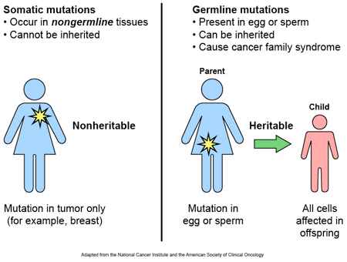

Inherited vs Acquired
Variation
Germline
Somatic

Slide 36
Tumors acquire mutations and can be heterogeneous
Normal
Tumor

Slide 37
Germline SNV/Indel Calling
(GATK, Samtools, etc)
Somatic SNV/Indel Calling
(Mutect2, VarScan, etc)
Looks for mismatches and gaps in the alignment to the reference
Assumes 2 copies of each allele
In some cases uses a database of known common SNPs to support variant calls
Compares tumor/normal mismatches and gaps in the alignment to the reference
Sensitive to low frequency mutation
In some cases uses a database of known cancer mutations to support variant calls

Slide 38
How do we find the oncogenic driver?
Identify a list of candidate genetic mutations.
FISH
Microarray
Sanger Sequencing
Next-generation Sequencing
Find the genes effected by these mutations
Determine the likely functional consequence of these mutations
Differentiate rare human variation with somatic mutations
Determine which mutations are likely to be “clinically actionable.
FDA approved drugs
Clinical Trials
Determine if the profile of these mutation are clinical actionable (immunotherapies)

Slide 39
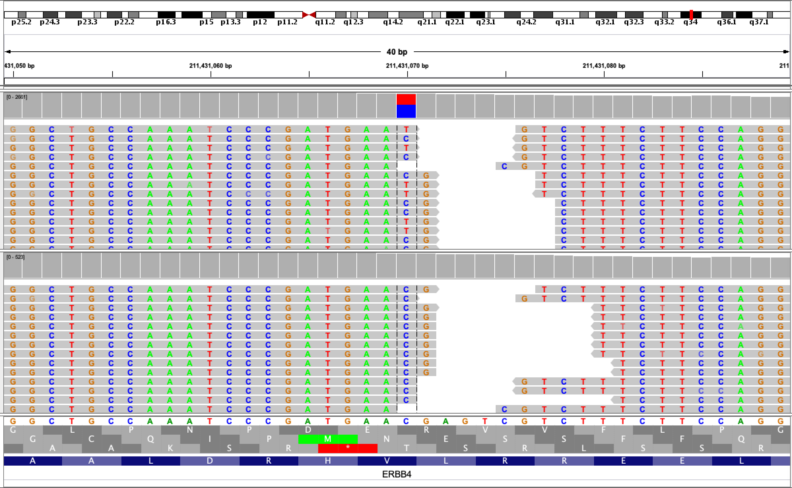
Mutational Effects
AAC -> AAT
Val -> Ile

Slide 40
Population Allele Frequency
1000 Genomes
A project to sequences ~3K people from a diverse set of genetically isolated populations and known admixture populations
ExAC (Exome Aggregation Consortium)
An aggregation of several large exome sequencing projects (~60K WES)
GnomAD (Genome Aggregation Database)
An aggregation of several large exome sequencing projects (~125K WES) and whole genome sequencing projects (15K WGS)
Common mutations are unlikely to cause cancer

Slide 41
Databases for Known Disease Associated Variation
ClinVar
ClinVar is a freely accessible, public archive of reports of the relationships among human variations and phenotypes, with supporting evidence
GWAS Catalog
The Catalog is a quality controlled, manually curated, literature-derived collection of all published genome-wide association studies assaying at least 100,000 SNPs and all SNP-trait associations with p-values < 1.0 x 10-5
Decipher
The DECIPHER database contains data from 20305 patients who have given consent for broad data-sharing; DECIPHER also supports more limited sharing via consortia.

Slide 42
Databases for Cancer Studies and “Knowledge”
Clinical Interpretation of Variants in Cancer (CIVIC)
Manually Curated Knowledgebase
Catalog of Somatic Mutation in Cancer (COSMIC)
Gene Fusions
Gene Census
Curated Genes
Drug Resistance (so far 9 genes)
Genome Wide Screens

Slide 43
Prioritization of Variants
Not common in the general population
Loss/Gain of function mutations
Splice
Stop gain/loss
Start gain/loss
Coding frame shifts
Non-synonymous Mutations
Amino Acid Changes
Variants Likely to Change Expression
Transcription Factor Binding Sites
miRNA Targets

Slide 44
Variant Functional Classification in Cancer
Tier 1
An FDA approved drug to treat cancers with this mutation
Tier 2
A clinical trial is available for patients with this mutation
Tier 3
Variant of Unknown Significant (VUS)
Tier 4
Benign

Slide 45
Tumor Mutational Burden
Tumor mutational burden is a predictor for the response to immunotherapies
Tumor cells with high TMB may have more neoantigens, with an associated increase in cancer-fighting T cells in the tumor microenvironment and periphery. These neoantigens can be recognized by T cells, inciting an anti-tumor response.

Slide 46
Overview of UT Southwestern Precision Genomics
NGS Sequencing Facility
Clinical NGS Laboratory
CLIA approved Assays
Clinical Bioinformatics
Attending Physicians
Patient
Care
Molecular Pathologist
Clinically-Interpreted Genomics Report

Slide 47
Hallmarks of a Good Test
Must identify tumor driving mutations in FFPE for targeted therapy.
Must be able to do so with minimal tissue
Must determine is variant is expressed.
Must eliminate rare germline SNPs. (Tumor/Normal Pairs)
Characterize mutational load for immunotherapy options.
Must identify and refer for available clinical trials.
Must retain the raw sequencing files for research and reiterative analysis.

Slide 48
Small Gene-Panel Testing
Colon
KRAS, NRAS, and BRAF
Lung
EGFR, KRAS, BRAF, PIK3CA, AKT, ERBB2, NRAS, MEK
Melanoma
BRAF, KIT, and NRAS

Slide 49
Hotspot Testing
Ion Torrent, 50 gene panel
Hotspot regions, including ~2,800 COSMIC mutations of 50 oncogenes and tumor suppressor genes, with broad coverage of the KRAS, BRAF, and EGFR genes

Slide 50
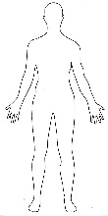
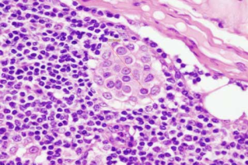
Large Tumor/Normal Panel Testing
FFPE section
Tumor
Paired germline DNA
Saliva or blood
Macro or Microdissection
Allprep
Protocol
DNA (>150 ng)
RNA (>200 ng)
500 ng
Kapa Hyper Plus
20 ng
Illumina RNAseq
Library preparation
Genomic Sequencing
Library
RNA-SEQ Library
7 cycle PCR
NimbleGen 1385
PanCancer panel
UMIs
200 ng
TruSight Pan Cancer
1385 Target enrichment
Target enriched exome sequencing library
Target enriched RNAseq library
PE75 with ~40M PF clusters
60-65% on target (>1000X coverage)
HISEQ 4000 (1 lane)
or NextSeq550 (HD flow cell)
MiSeq DX
PE75 with
5M PF Clusters
FASTQ files to Bioinformatics
FASTQ files to Bioinformatics

Slide 51
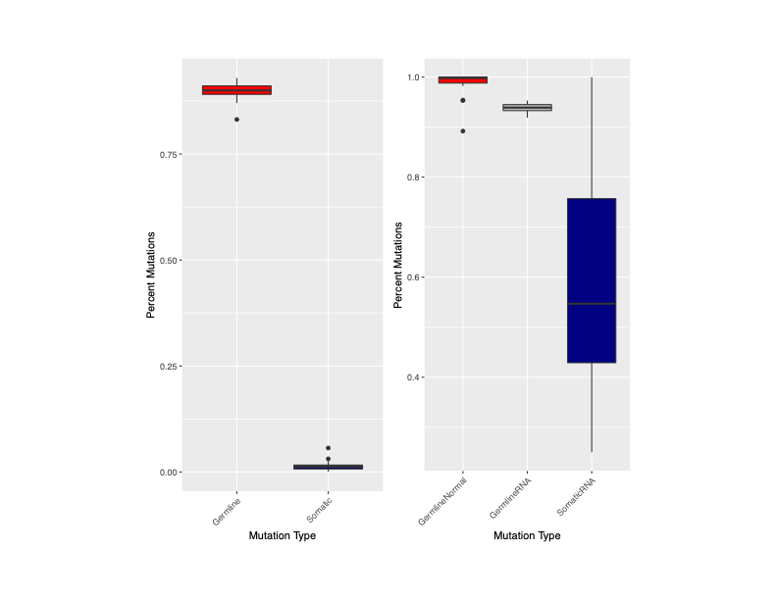
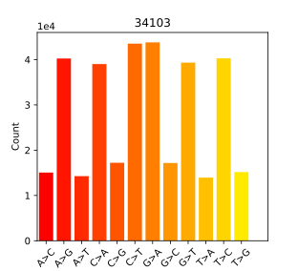
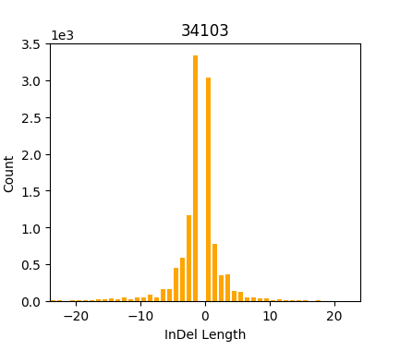
SNV and Indels
Small % are Somatic
100-200 Pass Filter Variants in CDS
10-20 Contamination or Noise
0-10 Reportable
10-20 Somatic
80-160 Germline
MSH6 | p.Lys632fs | Likely pathogenic
ATM | p.Ser274fs | Likely pathogenic
FANCM | p.Ser1746* | Likely pathogenic
PMS1 | p.Glu543* | Likely pathogenic

Slide 52
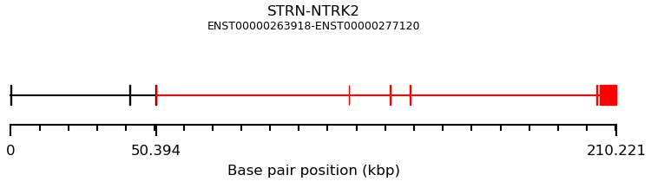
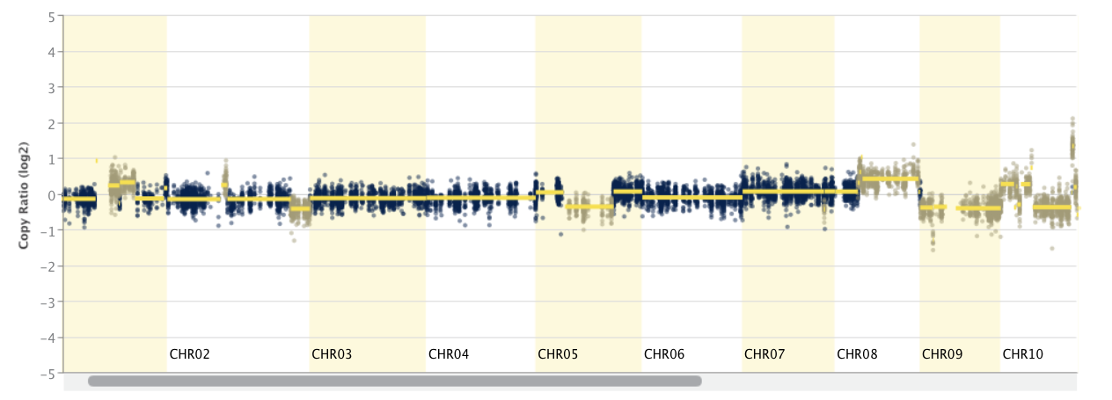
CNVs and Gene Fusions
FusionName | Junction Read Count | Spanning Frag Count | Large Anchor Support | FFPM | Left Break Dinuc | Right Break Dinuc | CDS_LEFT_ID | CDS LEFT RANGE | CDS RIGHT ID | CDS RIGHT RANGE | PROT FUSION TYPE
STRN--NTRK2 | 81 | 34 | YES_LDAS | 15.8797 | GT | AG | ENST00000263918.8 | 1-412 | ENST00000277120.7 | 1445-2517 | INFRAME
STRN--NTRK2 | 17 | 28 | YES_LDAS | 6.2138 | GT | AG | ENST00000263918.8 | 1-412 | ENST00000277120.7 | 1397-2517 | INFRAME
Gene | Alteration | Copy Number Change
CDKN2A | CDKN2A_Deletion | 0
CDKN2B | CDKN2B_Deletion | 0
FGFR2 | FGFR2_Amplification | 6
FGFR2
CDKN2A
CDKN2B

Slide 53
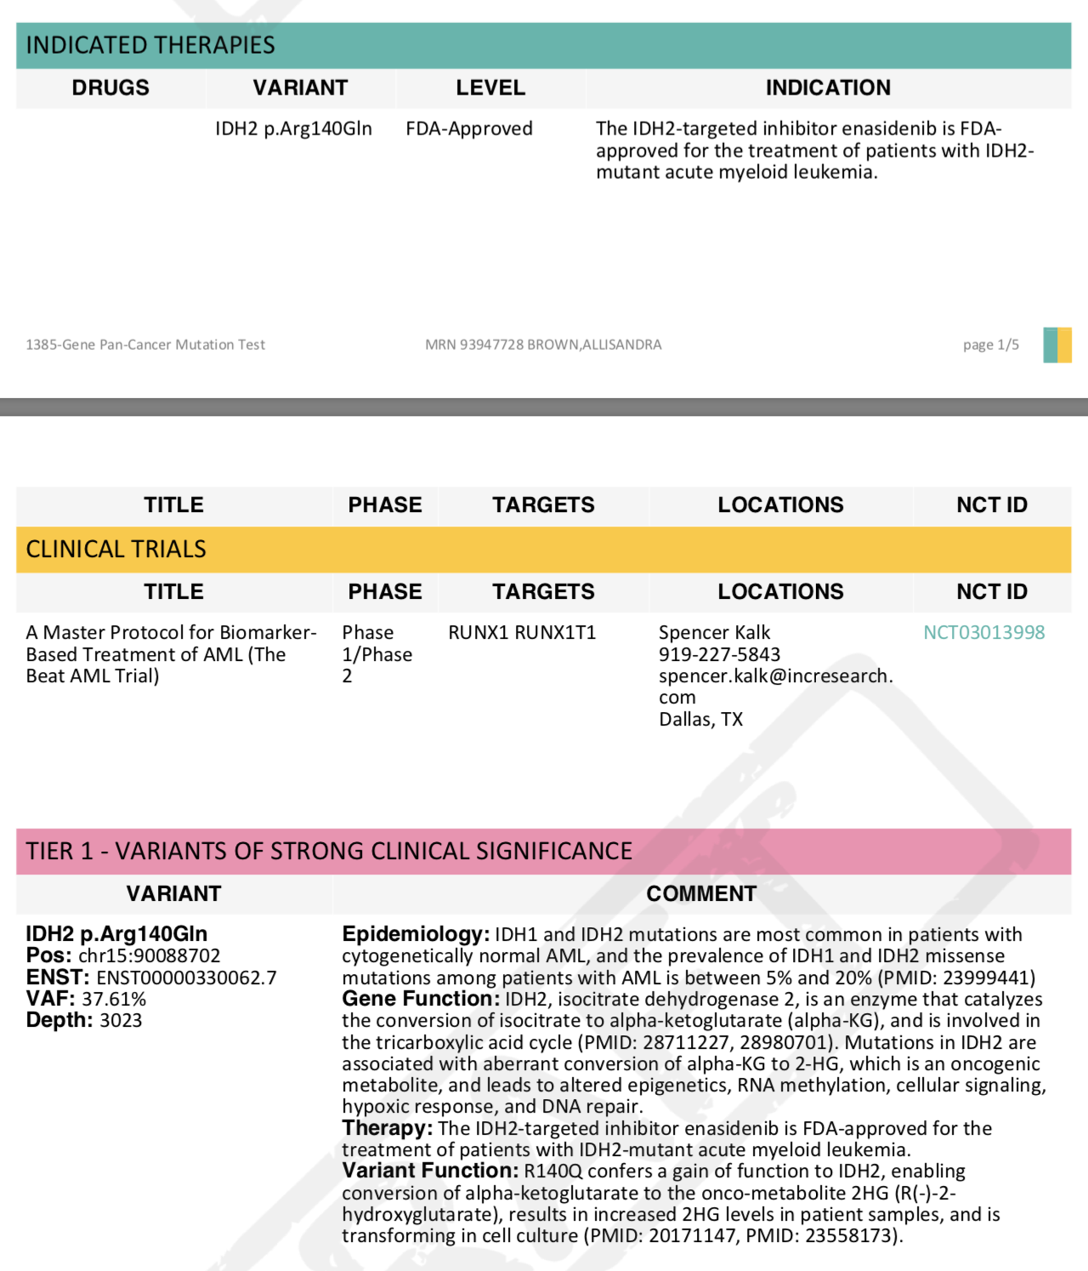
Reporting
Indicated Therapies
Clinical Trials
Clinical Annotations

Slide 54
Integrative Reporting
In the future, we will be able to add discrete data elements to EPIC (EHR) for genetic testing
Discrete data elements (as opposed to pdfs) will allow for the integration of pathology reports — FISH, NGS, IHC, etc

Slide 55
Oncologist Initiated Clinical Trials
Variant Predictions
UTSW Clinically Operable Interpretations kNowledgebase
Patient Mutational Profile Comparison
Clinical Research Database
Mutation Predicted
Treatment & Clinical Trials
Change in Treatment
Patient Outcomes

Slide 57
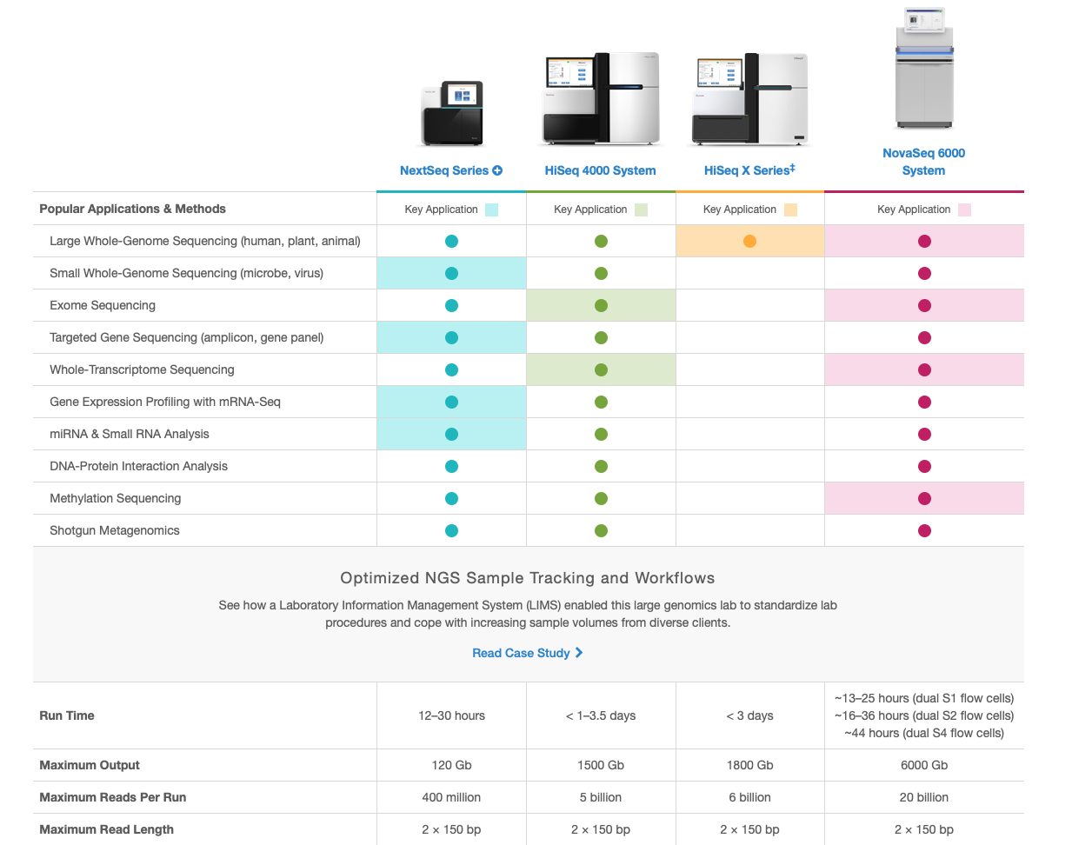

Slide 58
Short Read Aligners
Seeding represents the first few tens of base pairs of a read. The seed part of a read is expected to contain less erroneous characters due to the specifics of the NGS technologies.
Read GATCGCAGAGCTCGGGCATAGCTAGCGC
Seed
AGCTATGATCGCAGAGCTCGGGCATAGCTAGCGCTAGAGCTCGCGATCGCAGAGTCGA
Genome

Slide 59
History of Sequencing
Robert Holley and colleagues were able to produce the first whole nucleic acid sequence; Fred Sanger and colleagues developed a related technique based on the detection of radiolabelled partial-digestion fragments after two-dimensional fractionation
Using Sanger’s method, Walter Fiers' laboratory was able to produce the first complete protein-coding gene sequence
Watson and Crick solve the three-dimensional structure of DNA, working from crystallographic data produced by Rosalind Franklin and Maurice Wilkins
Alan Maxam and Walter Gilbert developed an early DNA sequencing method using nuclease
Frederick Sanger and colleagues develop a method of sequencing involving random termination
Pål Nyrén and colleagues develop pyro-sequencing
Shankar Balasubramanian and David Klenerman, and developed a sequencing method based on reversible dye-terminators technology, and engineered polymerases.
Stephen Turner and colleagues describe single molecule real time DNA Sequencing (SMRT)
Oxford Nanopoe Introduces the MinIon at AGBT
1953
1965
1972
1973
1977
1996
1998
2008
2012

Slide 60
Short Read Aligners
CTCGGGCATAGCTAGCGC
GATCGCAGAG
||||||||||
AGCTATGATCGCAGAGCTCGGGCATAGCTAGCGCTAGAGCTCGCGATCGCAGAGTCGA
Genome

Slide 61
Short Read Aligners
TCGGGCATAGCTAGCGC
GATCGCAGAGC
|||||||||||
AGCTATGATCGCAGAGCTCGGGCATAGCTAGCGCTAGAGCTCGCGATCGCAGAGTCGA
Genome

Slide 62
Short Read Aligners
CGGGCATAGCTAGCGC
GATCGCAGAGCT
||||||||||||
AGCTATGATCGCAGAGCTCGGGCATAGCTAGCGCTAGAGCTCGCGATCGCAGAGTCGA
Genome

Slide 63
Short Read Aligners
Mismatches and Gaps can indicate a genetic variation (naturally occurring in a population) or mutation (an error in replication)
GATCGCAGAGCTCGGGCTTAGCTAGCGC
||||||||||||||||||||||||||||
AGCTATGATCGCAGAGCTCGGGCATAGCTAGCGCTAGAGCTCGCGATCGCAGAGTCGA
Genome

Slide 64
Short Read Alignment
Gaps
Existence of indels necessitates inserting or deleting nucleotides while mapping a sequence to a reference genome (gaps). The complexity of choosing a gap location increases with the read length.
ATTGACCTGA
||||||||||
AT—-—CCTGA
ATTGACCTGA
||||||||||
A-T-—CCTGA

Slide 65
Gene Annotations and Effects
snpEff
Changes affecting genes
Changes affecting regulatory regions
ENCODE
Epigenome Roadmap
NextProt
proteomic annotations
Motifs
VEP
Changes affecting genes
Changes affecting regulatory regions
Integrated with downstream tools like cBioporal and GenVisR

